Slide 1

S4 Final Project Tesla
Eric Yu

Slide 2
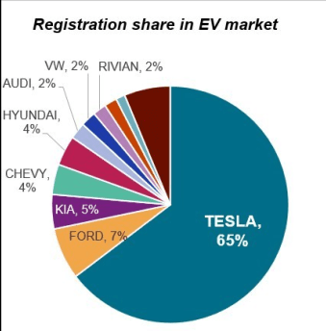
Strengths
Hiring
Name Recognition
Marketing Strategy
Innovation
Market Dominance

Slide 3
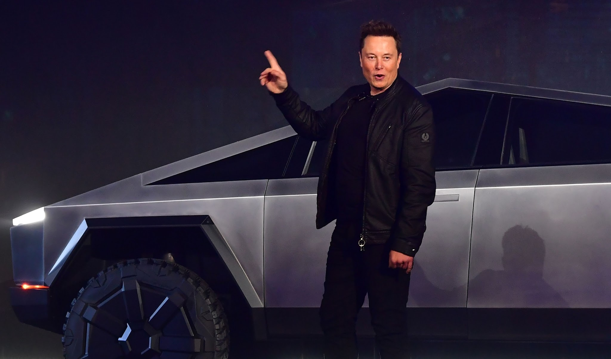
Weaknesses
Unreliable Targets
Manufacturing Delays
Controversial CEO
Cost

Slide 4
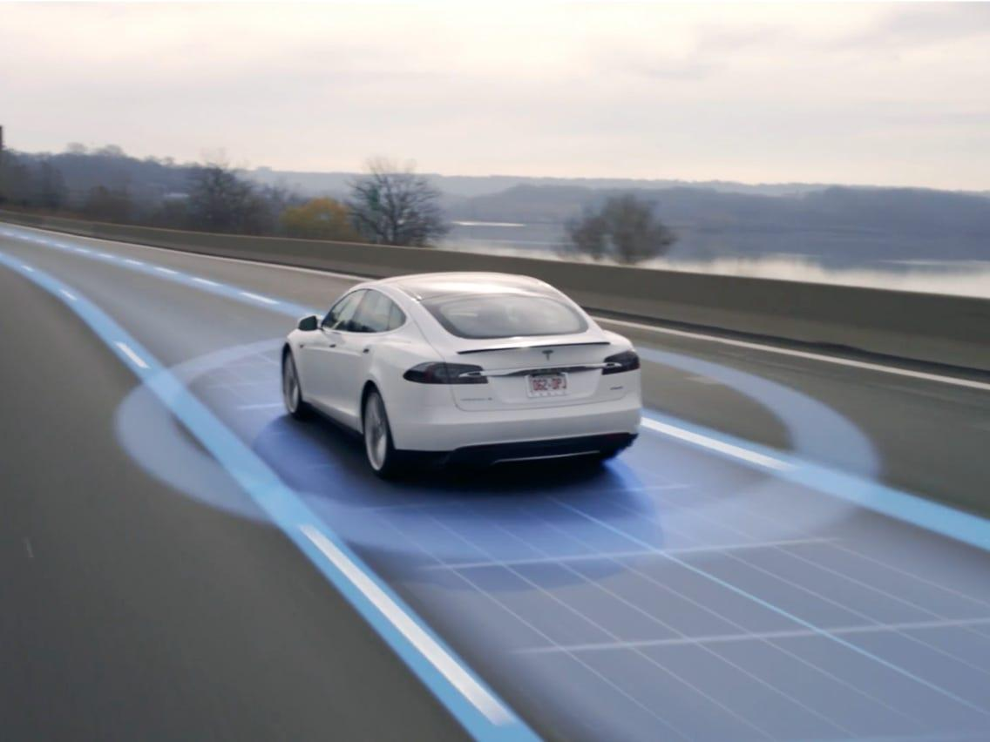
Opportunities
More Products
Affordability
Auto Pilot
Further Innovation

Slide 5
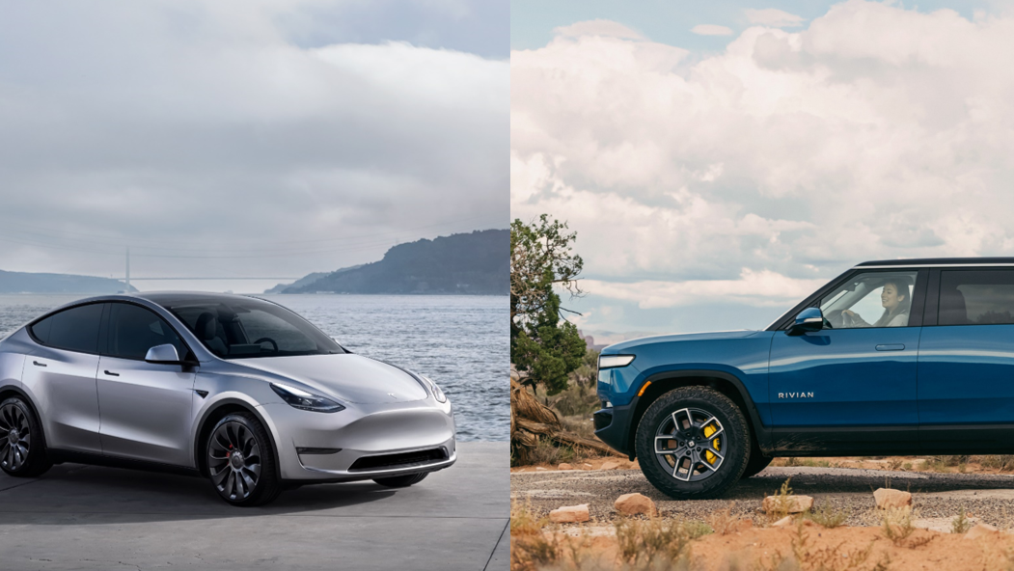
Threats
Other EVs
Laws
Consumer Adaptability

Slide 6
Diversity, Equity, and Inclusion
66% of Tesla’s employees are from underrepresented communities, but drops to 39% for employees in leadership positions.
Focus on attracting, developing, and retaining talent
Integrate diversity, equity and inclusion principles and practices into the DNA of the company
Connect communities internally and externally to opportunities with Tesla

Slide 7
Organization Structure
Tesla has a functional structure
Organized into different departments based on areas of expertise such as research, design, development, marketing, finance, and HR.
Clear path forward
Specialization

Slide 8
The Current Event

Slide 9
Tesla shareholders approve $46 billion pay package for CEO Elon Musk

Slide 10
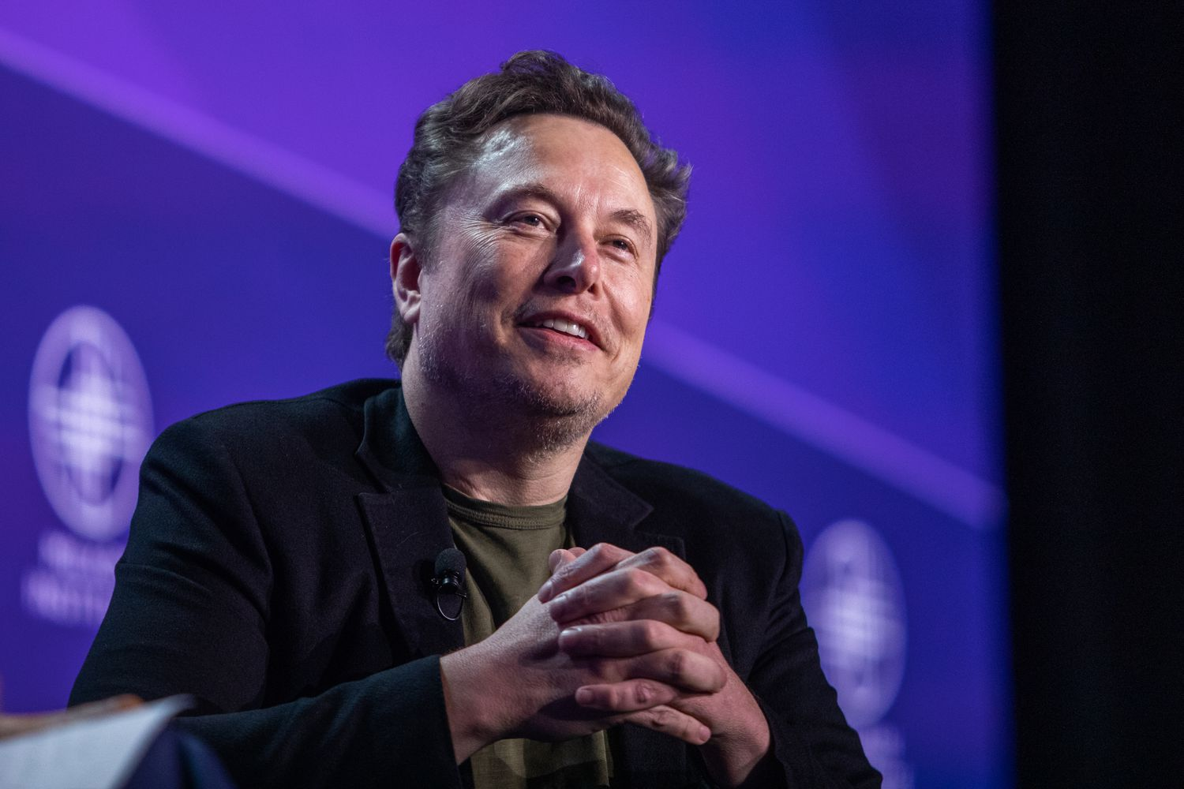
Impact
Musk gets a payday
More likely for Musk to stay
304 million shares
Biggest pay package for CEO ever
Ethical

Slide 11
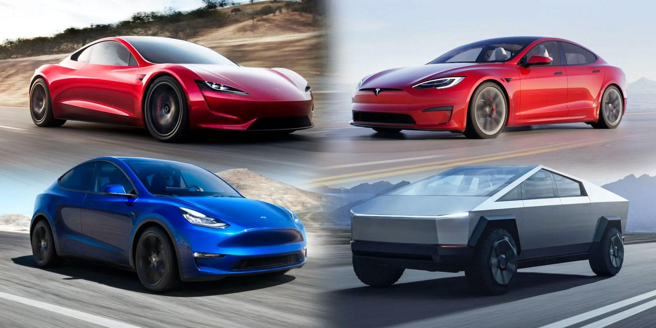
What’s Next?
Musk will continue to innovate
Compensation for shareholders and employees
Dispute with court
Uncertain turnout

